Slide 1
Handwriting Number Recognition
Hanyi Zhang, Linqiao Shang, Xin Li

Slide 2

Introduction
Picture Recognition is a hot topic these years due to the development of Machine Learning and Artificial Intelligence.
It’s an easy task for human to read handwritten words and digits. But it take much more time for machines to decide.
We start with digits recognition due to its less outputs and symbol for words.

Slide 3
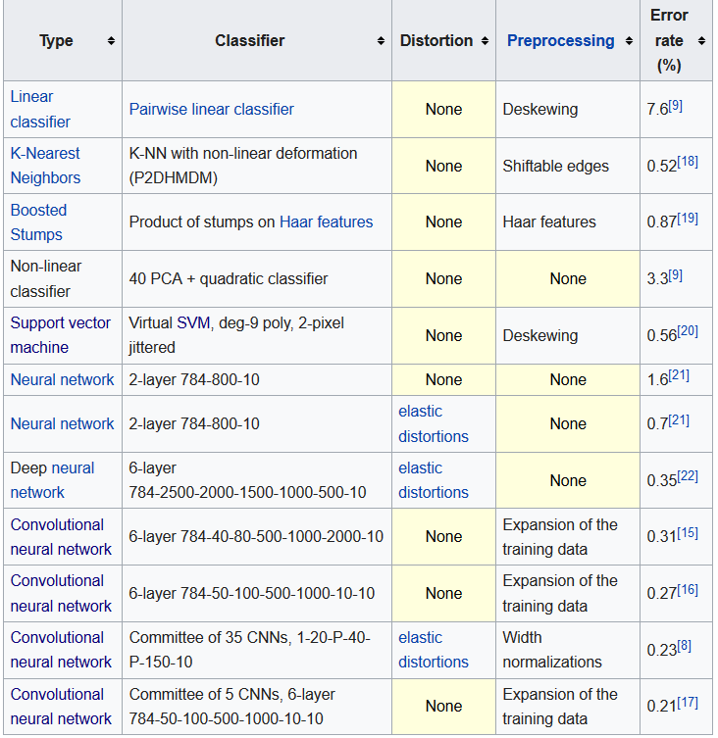
Related Works
In 1998, a best-case error rate of 0.42 percent was achieved on the database by researchers using a new classifier called the Gradient-Based Learning.
In 2016, an error rate of 0.21 percent, improving on the previous best result, was reported by researchers using a method called convolutional neural networks

Slide 4
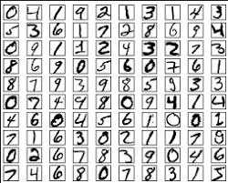
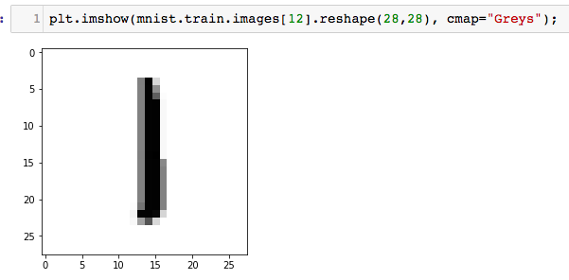

MNIST database
The MNIST database (Modified National Institute of Standards and Technology database) is a large database of handwritten digits that is commonly used for training various image processing systems.
The MNIST database contains 60,000 training images and 10,000 testing images. Each individual digit is an array with 784 (28x28) values. Each value represents the color for one pixel. If we reshape a training sample to 28x28 and plot it, we can see the original digit, and we could also see the label of this digit. The label format is the one-hot encoding style. This means that the label corresponds to the index of the array where the value is 1.

Slide 5
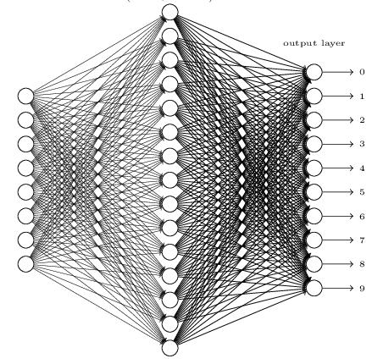

Neural Network
Input Layer
Hidden Layer
Output Lay
$C\left(w,b\right)≡\frac{1}{2n}\sum_{x}{{|\left|y−a\right||}^{2}}$
$w_{k}^{′}=w_{k}−\frac{η}{m}\sum_{j}{\frac{∂C_{Xj}}{∂w_{k}}}$
$b_{l}^{′}=b_{l}−\frac{η}{m}\sum_{j}{\frac{∂C_{Xj}}{∂b_{l}}}$

Slide 6
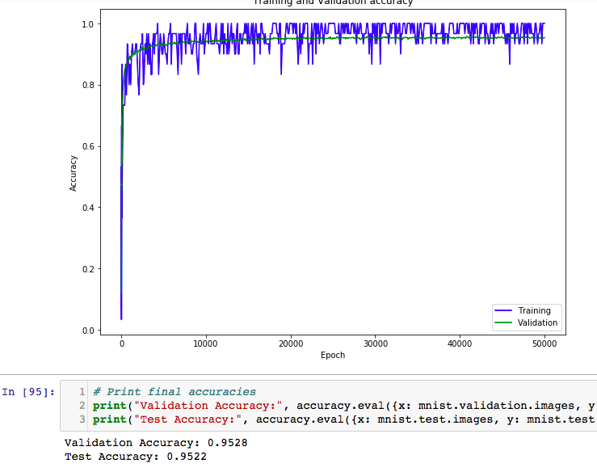
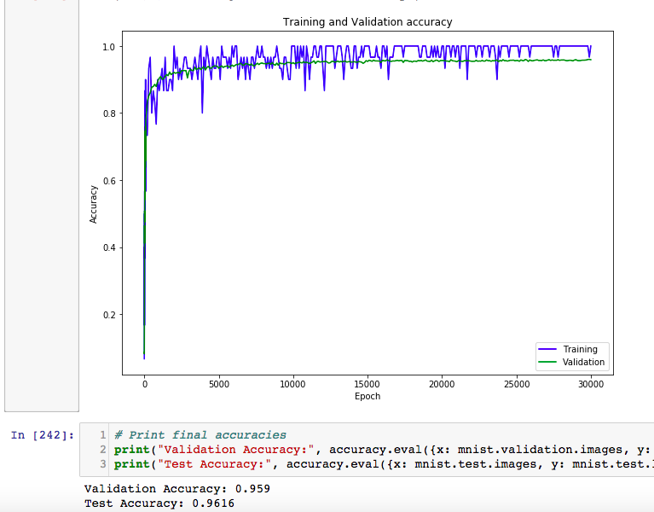
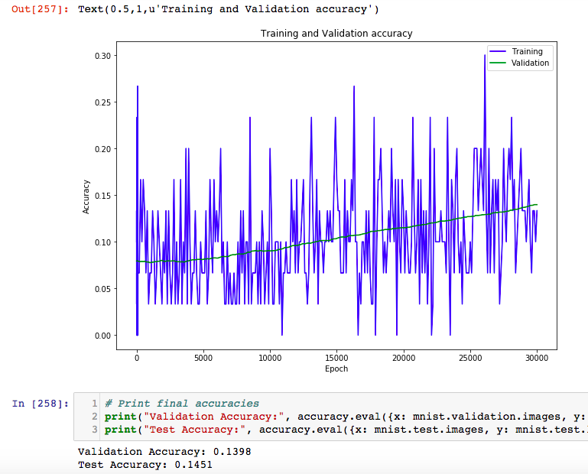
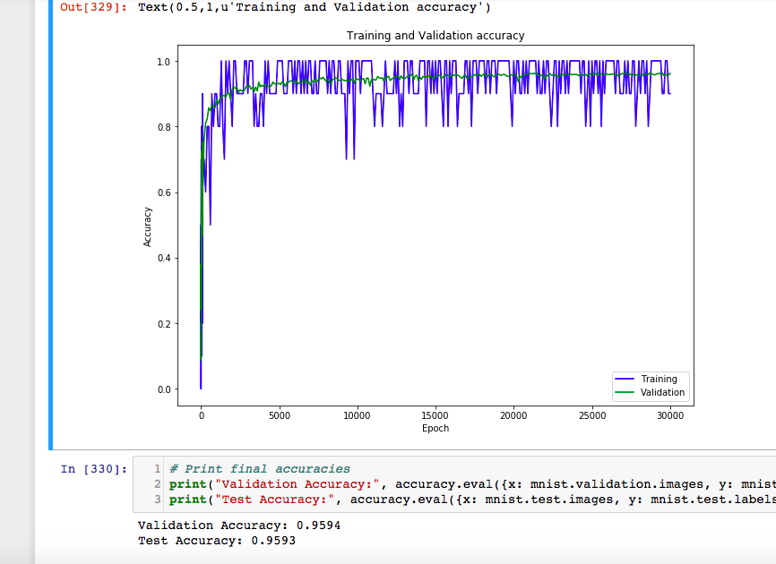
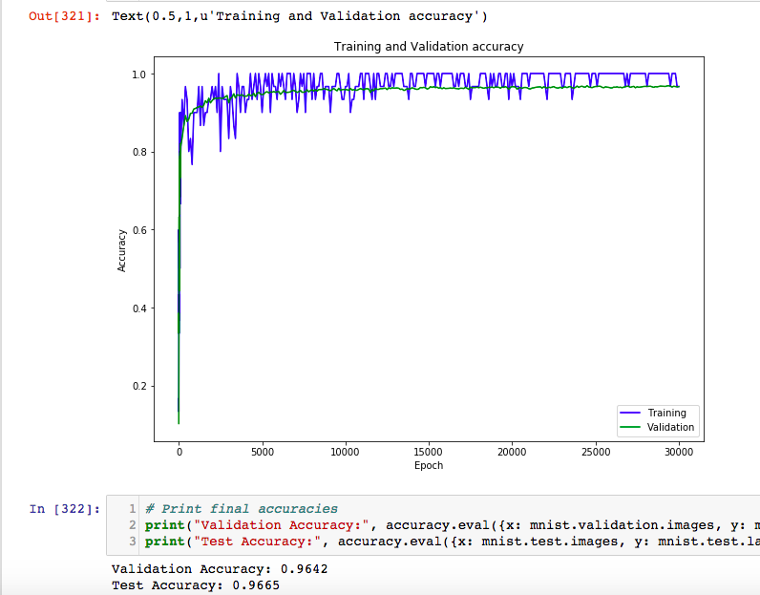
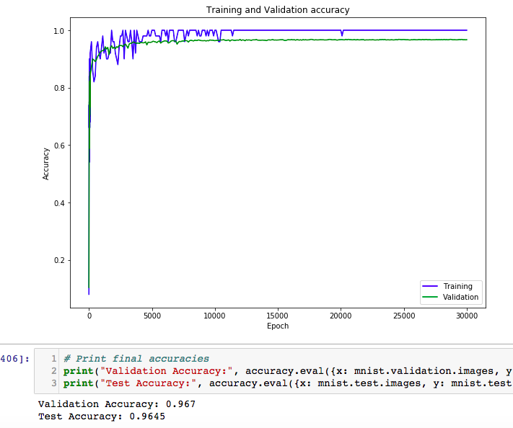
Neural Network Result
n = 30, η = 1.0, m = 30 n = 100, η = 1.0, m = 30 n = 300, η = 0.001, m = 30
n = 300, η = 1.6, m = 30 n = 300, η = 1.6, m = 10 n = 300, η = 1.6, m = 50

Slide 7
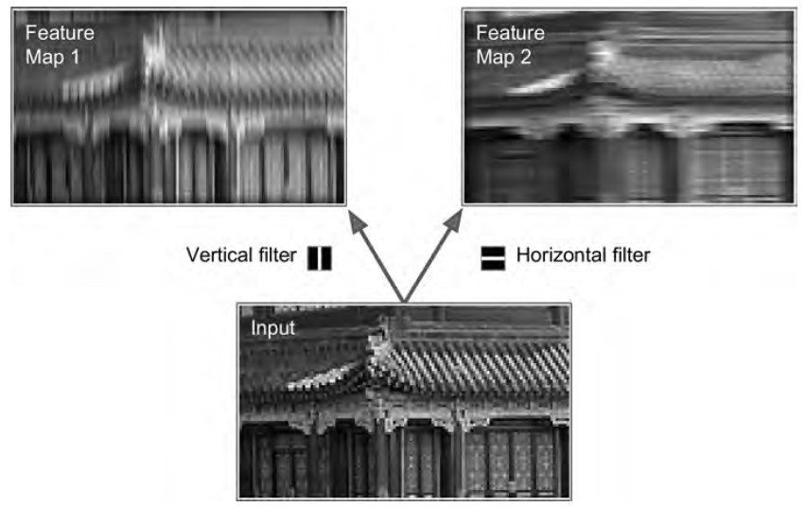
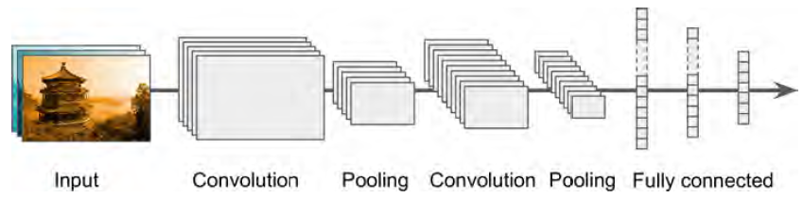
Convolution Neural Network Solution
Convolutional layer
Pooling layer
Fully connected layer
Dropout layer (optional )

Slide 8
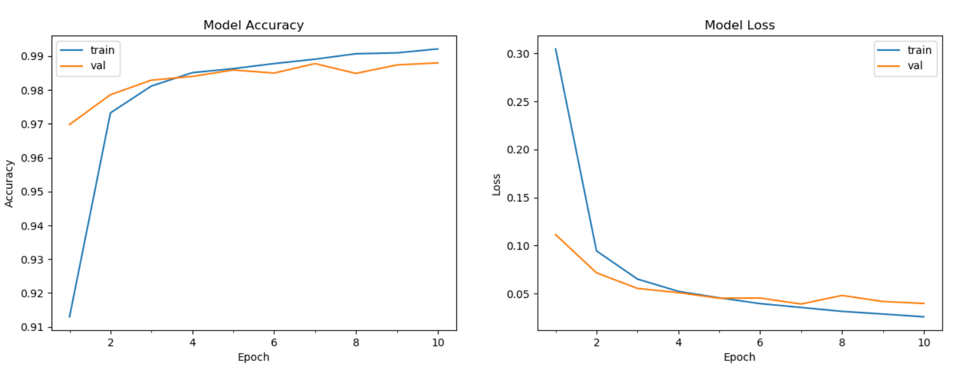
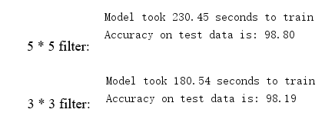
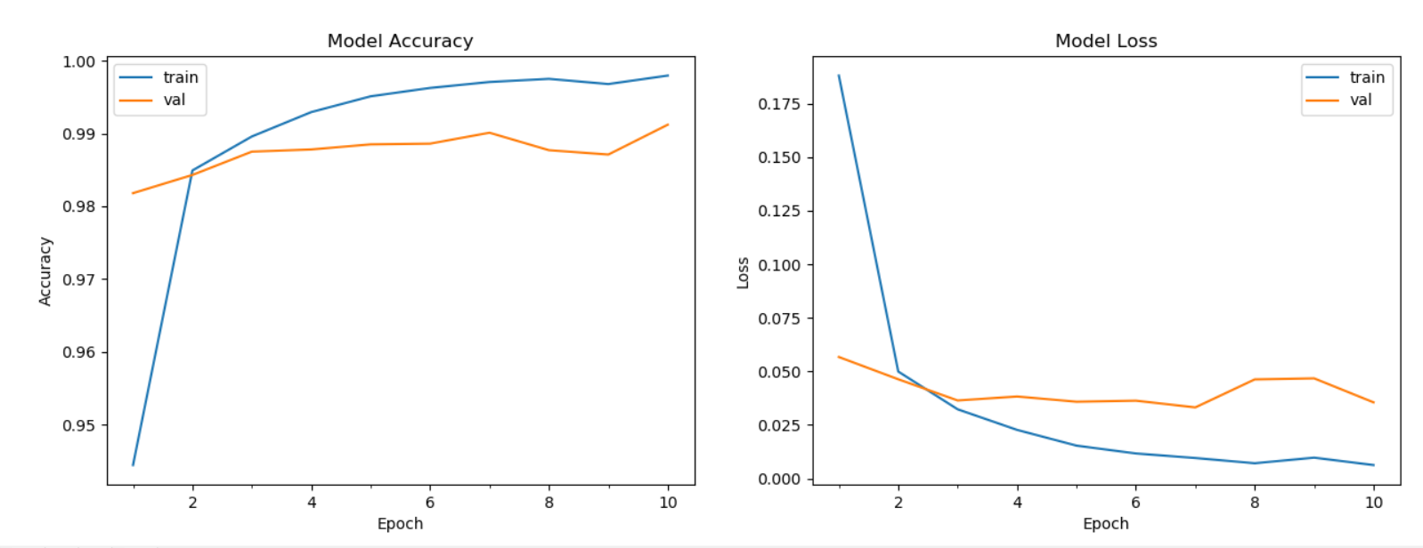

Convolution Neural Network result
1 convolutional Layer (5*5)
2 convolutional layers (3*3)

Slide 9
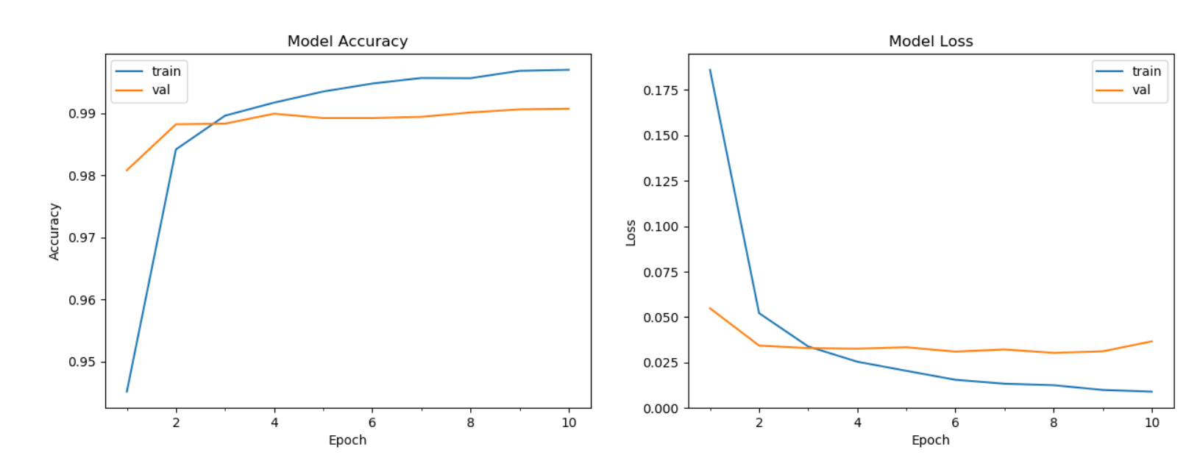

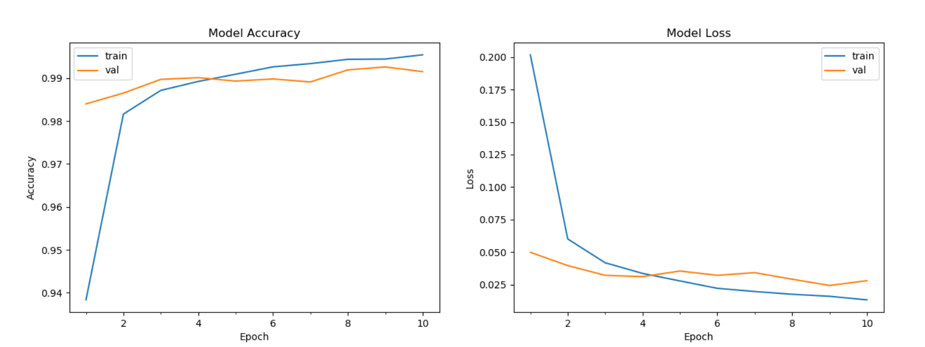

Convolution Neural Network result
Add drop out layer
Dropout parameter = 0.1
Add drop out layer
Dropout parameter = 0.2

Slide 10
Comparison
Accuracy : the CNN has reached the accuracy of 0.9915 and the Neural Network reached 0.967. Although we can always adjust some of the parameters to optimize the result. But the result clearly shows that the CNN is better than Neural Network in handwriting digit recognition problem.
Training Time: the Neural Network takes about 150s to train, but the CNN takes 230 seconds if using 5*5 filter. It may seem like neural network method trains faster than CNN. But theoretically the CNN should be faster than neural network. We consider this as a lack of input dimensions. Here we only take 28x28 as the input diameters. If we add one more dimension of the picture---color. The result should be CNN faster than neural network.
Parameters/Weights : they both use quite different parameters, due to their characteristics. But it clearly shows that the CNN has less parameters than Neural Network. And quite easy to understand what the parameter is and easy to adjust.

Slide 11
Conclusions and Improvements
We can use deep learning method, introducing much deeper (and larger) networks to be trained. Like adding more hidden layers.
If time is curtail to a training process. Less layers or even less inputs can be applied to learning.
Parameters can be tuned to improve the training. And Epochs can be applied more times to ensure the accuracy.
Highest accuracy of 0.9915 has been achieved.

